Slide 1

Predicting Covid 19 Symptoms by Analyzing Search Results
Final Project
IST 687 – Intro to Data Science
Brandon Stanyer

Slide 2
Contents
Research Objective
Data Set Overview
Hypothesis
Research & Visualizations
Models & Predictions
Results & Analysis

Slide 3


Research Objective
Objective:
Examine the past 2 years of Covid-19 data, with a data science lense, to understand how as a society we can predict the most likely symptoms of Covid-19 as the virus continues to adapt and change. We hope to leverage Google Search data and statewide symptom reporting to understand if there is a correlation.
Selecting a Data Set:
Identify the most complete Data Set for symptom reporting
Identify most relevant Symptoms to explore
Ensure data set has a minimum of 10,000 values (at least 10 attributes and 1,000 observations)
Guidelines:
Build Visualizations and Models in R
Leverage Data Science Techniques Learned in Class
Make a prediction – leveraging ML Models

Slide 4
The Impact
The Why:
COVID-19 has had a significant impact on society, not only from a public health perspective but also from an economic perspective. The pandemic has caused millions of deaths, led to widespread economic disruption, and fundamentally change how we think about public health.
The Evolution:
A method to predict when a spike is imminent can help us identify and treat the virus more effectively, improve decision making of practitioners and guide resource allocation during outbreaks. In practice, testing and clinics are not accessible to everyone, however the internet is widely available. Ultimately, search trends may provide valuable insights into the status of future spikes.
The Application:
Overall, predictive models of COVID-19 spikes can be a valuable tool for public health officials and healthcare providers. By using these models, we can better understand the virus, identify those who are most at risk, identify new cases earlier, improve contact tracing / containment efforts and develop new treatments. This information can help us to save lives and to mitigate the impact of the pandemic.

Slide 5
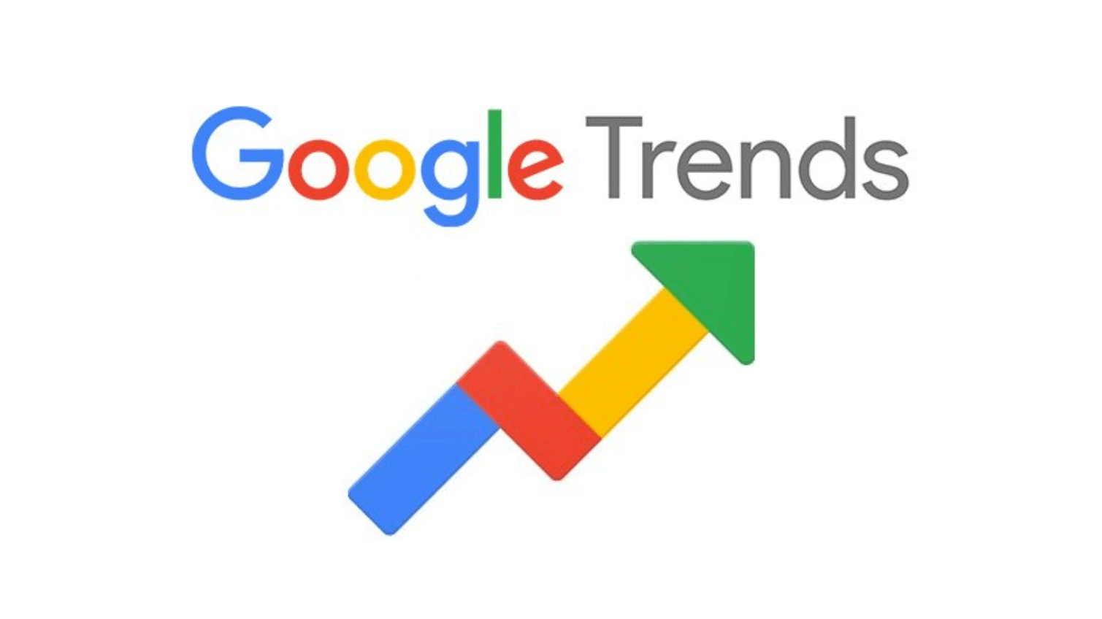

The Data
Data Sets:
Google – Search Trend Results
Our World in Data - Vaccine Records
NY Times (github) – Reported Covid Cases
Data Size: Our refined data set contained 9 variables and 1,028 rows
Type: A mix of categorical and numeric data
Attributes: Cases, Deaths, Vaccinations, Common Cold, Fever, Abdominal Pain, Fatigue and Anosmia
Challenges:
The data sets were separated by year, which required us to combine the data from the three years into one large data set -- before combining the search trends with the reported cases
The initial data set contained over 500 symptoms, we first had to decide which variables we wanted to include in our model. Ultimately, we chose of the most common symptoms
We had to combine two data sets, in order to have the compare the search trends with the total for reported cases by day. Formatting the data correctly to match the days up correctly was challenging

Slide 6
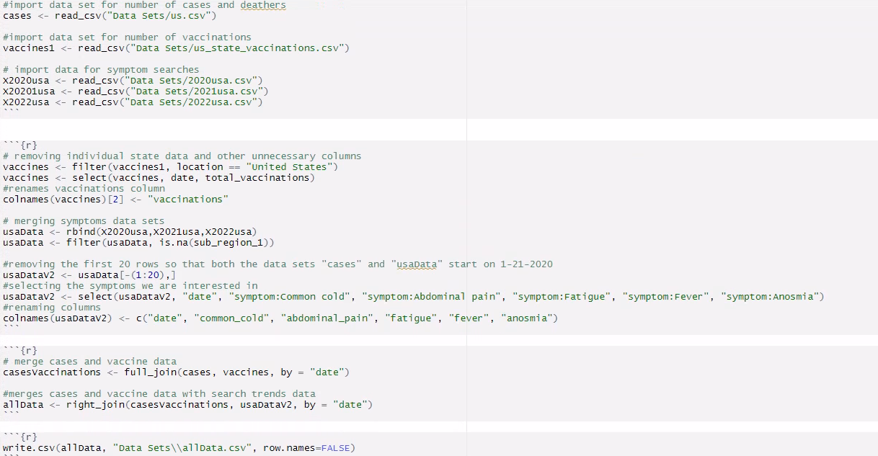
Data Clean Up
Insights:
Significant processing was required in order to merge these data sets
Once the data was read in, we needed to combine the search trend data for 3 years into one dataset
We then had to ensure the date range was the same for each data set
We also had to remove columns to include only relevant symptoms

Slide 7
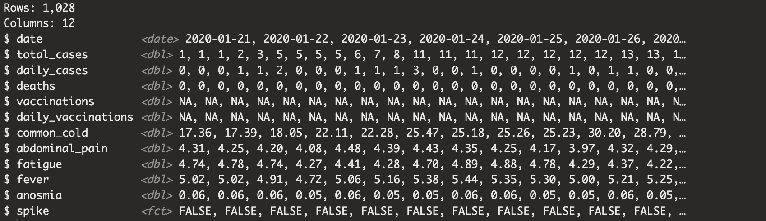
Data Snapshot
Our data set contains 12 variables. The variables are organized by date and definitions are shown on the next slide.

Slide 8
Data Snapshot – Variable Definitions
Covid-19 Variables Definitions:
date: The day from which the data is from
total_cases: The cumulative number of Covid-19 case reported in the united states
daily_cases: The number of Covid-19 reported in the United States from that day
deaths: The cumulative number of deaths reported from Covid-19 in the United States
vaccinations: The cumulative number of Covid-19 vaccinations administered
daily_vaccinations: The number of Covid-19 Vaccines administered in the United States that day
Symptoms Variables Definitions
~each of these variables are the popularity of these searches on google for that day. The value for each of the variables is a percentage of the United States population that searched for something including these terms.
common_cold: popularity of searches containing "common cold"
abdonminal_pain: popularity of searches containing "abdominal pain"
fatigue: popularity of searches containing "fatigue"
fever: popularity of searches containing "fever"
anosmia: popularity of searches containing "anosmia"
Variable to Predict
Spike: a true or false value that indicates if that day would be considered a spike in covid (spike = True when the daily cases is in the top 25% of cases above 123,968 cases)

Slide 9
How we Created Variables
Daily_Cases:
This variable was created by using the total_cases data. The code subtracts the previous value from the current day's value to determine how many new cases there were.
Daily_Vaccinations:
This variable was created by using the total_vaccines data. The code subtracts the previous value from the current day's value to determine how many new vaccinations there were.
Spike:
The spike column was created using the daily_cases data. The code classifies a spike by a having daily cases exceeding 123,968 cases. This value for determining spikes is the third quartile of daily_cases.

Slide 10


The Hypothesis
Hypothesis:
We feel like there is likely a positive correlation between Google search trends of those symptoms for the most common symptoms and a spike in cases. This means that as the number of people searching for COVID-19 related symptoms increases, so too does the number Covid-19 cases
This hypothesis is based on the idea that people are more likely to search for information about symptoms if they are experiencing them themselves or if they know someone who is experiencing them. This can give key insights to public health professionals; as the pandemic has become more normalized, people are becoming less vigilant and might not be as willing to be seen by a doctor or even get tested for Covid-19
Testing Hypothesis:
To test this hypothesis, we will combine the data set of search trends of the most common symptoms with the number of daily reported cases from 2020 through 2022 to do statistical analysis
If we find that there is a positive correlation between the Google search trends of symptoms and the number of cases, it would suggest that Google search trends can be used as an indicator of an upcoming Covid-19 spike. This information could then be used to help public health officials track the spread of the virus and to develop public health interventions to mitigate the impact of the pandemic.

Slide 11
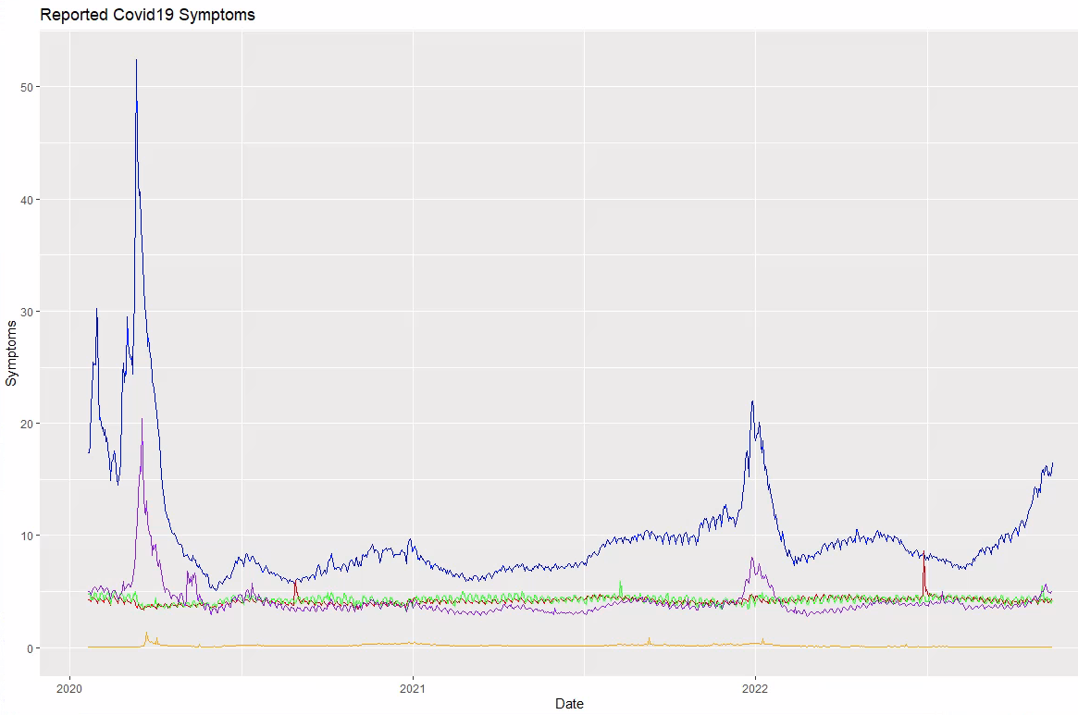

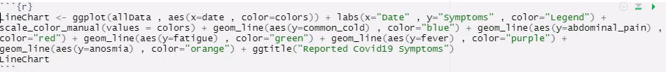
Initial Exploration:
This line chart shows the trend of each reported symptom over the course of two years.
You can see the first major spike in search trends happened in the beginning of 2020 and then a second smaller spike in the beginning of 2022.
Common Cold and Fever seem to be the most widely reported symptoms, with the biggest range.
Abdominal Pain, Fatigue and Anosmia stay relatively consistent
Legend
Common Cold
Abdominal Pain
Fatigue
Fever
Anosmia

Slide 12
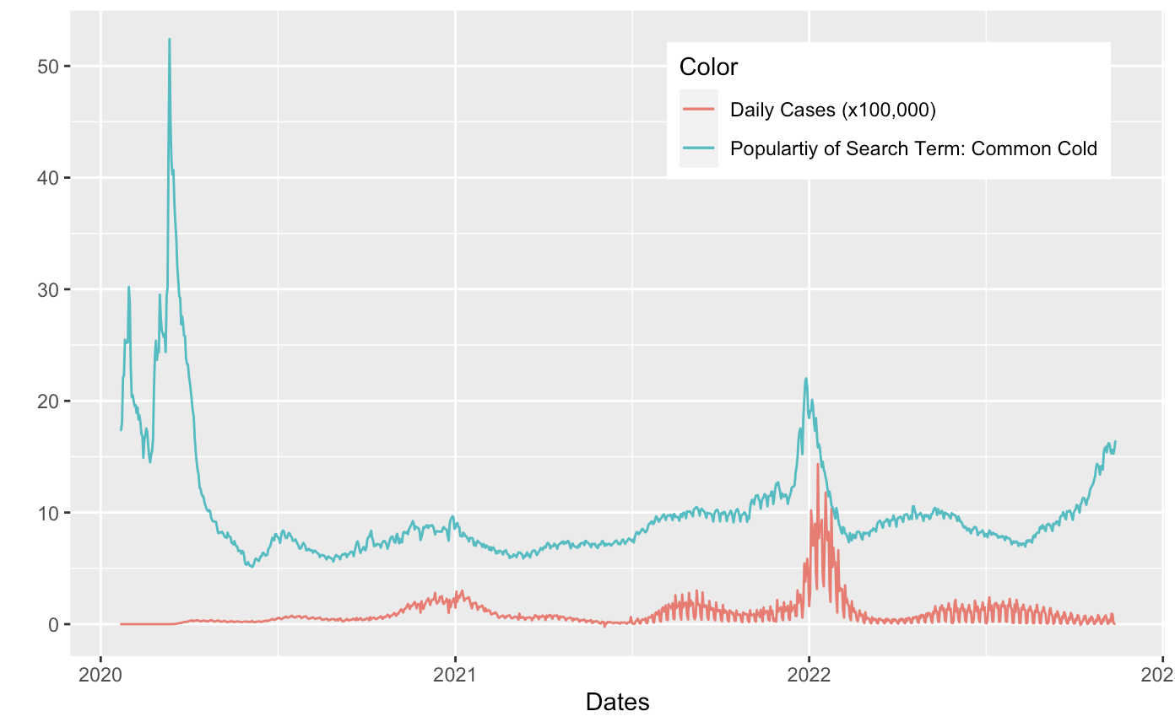
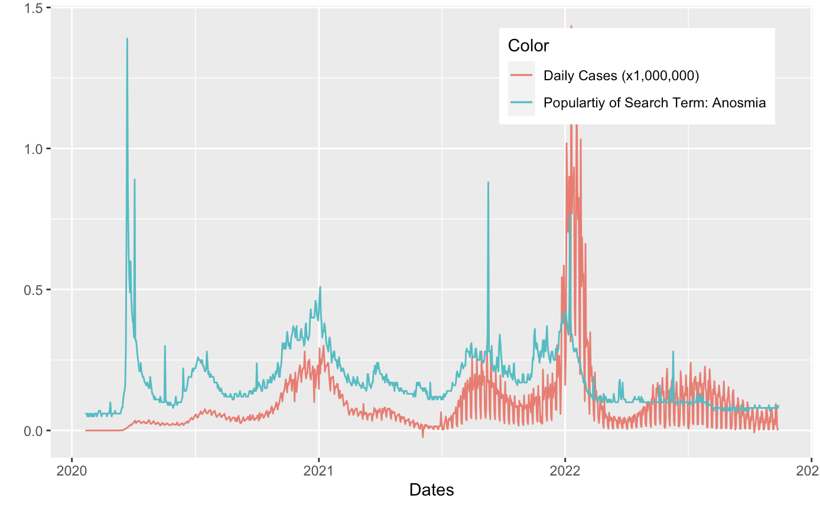
Visualizations Connecting Daily Cases to Popularity of Search Terms
The search terms "Common Cold" and "Anosmia" both have a clear connection to spikes in Covid-19 Cases.

Slide 13
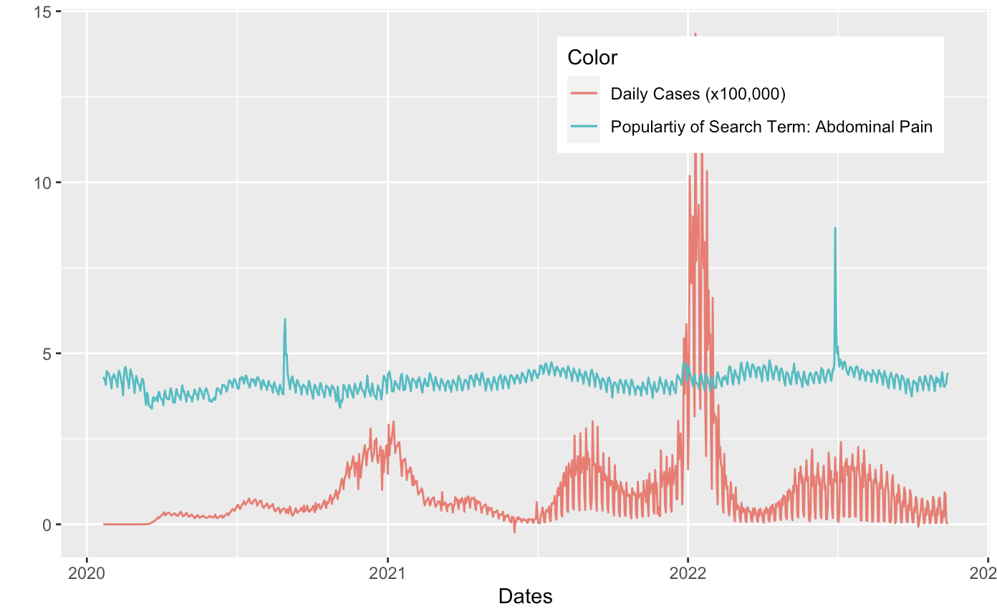
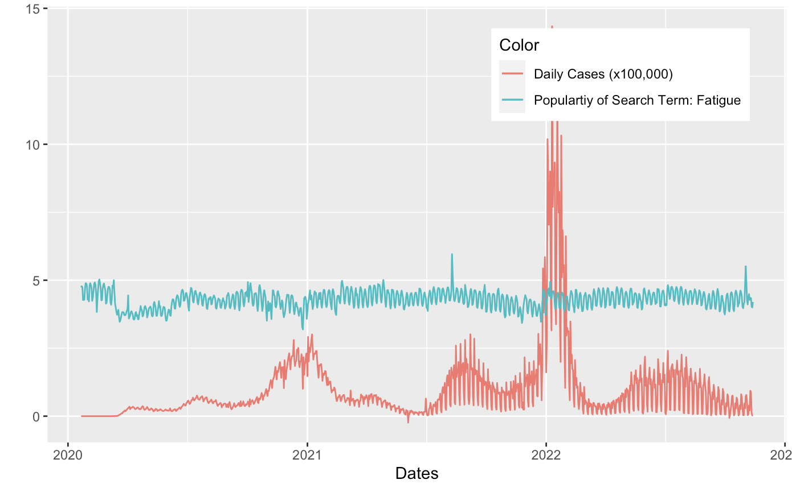
Visualizations Connecting Daily Cases to Popularity of Search Terms
The search terms "Abdominal Pain" and "Fatigue" do not appear to have a clear connection to spikes in Covid-19 Cases.

Slide 14

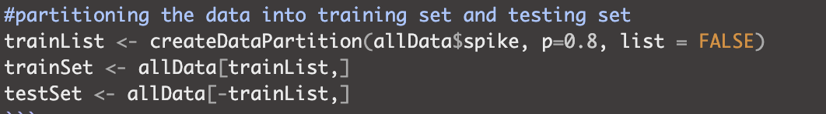
Overview & Training of Predictive Models
Overview:
The goal for our model is to predict when spikes in Covid-19 occur. We will be using the symptom search data to see if we can predict if a spike in Covid-19 cases is occurring.
By using search data, we can predict spikes in cases without the data which is normally needed, such as hospital data, which can be challenging to acquire.
Training:
For each of our models, 80% of the data was used to train the model and the other 20% was used to test the model. Each of the models predict the value of the spike variable using all five symptoms variables.

Slide 15
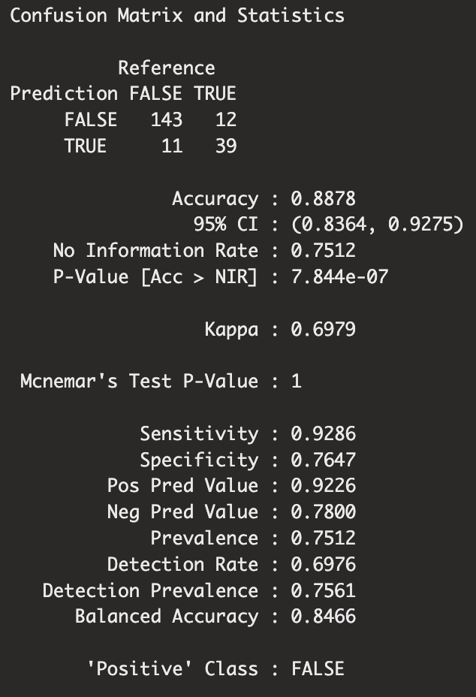
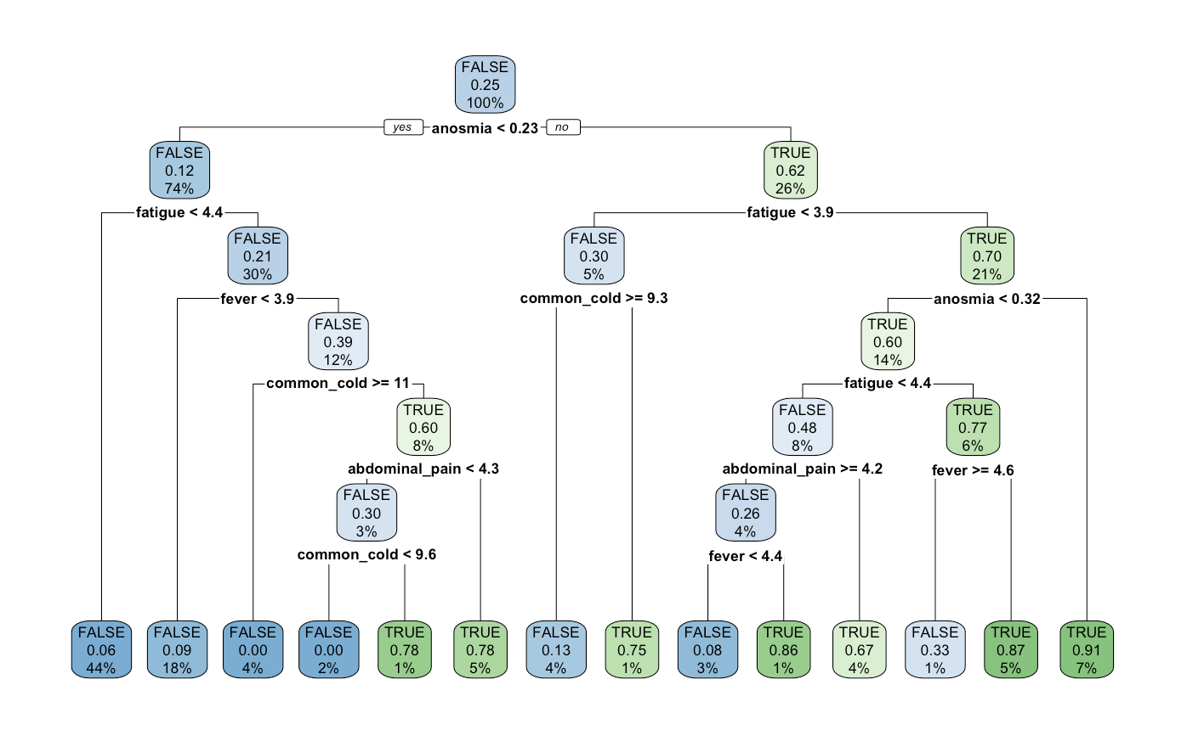
Predictive Model - Rpart
The rpart model showed that it could predict a spike given search data to a high degree of accuracy.

Slide 16
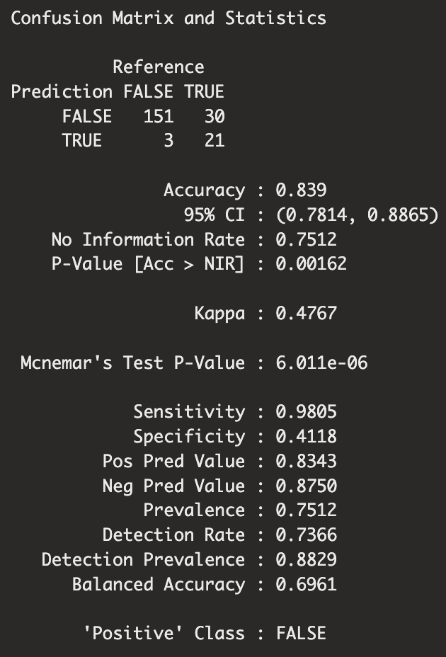
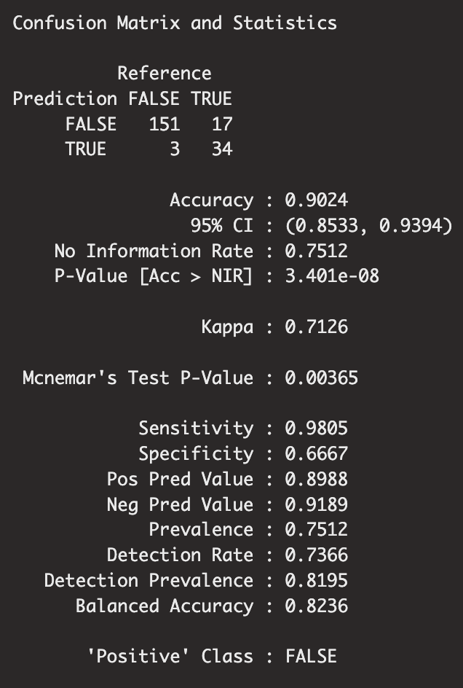
Other Predictive Models
SVM Linear SVM Radial
The SVM Linear model does not appear to as accurate in its predictions as the rpart model. For this reason, it will likely not be used.
The SVM Radial model shows minor improvements over the rpart model. It is slightly better in almost all regards.

Slide 17



Results & Analysis
From the data sets we used, we were able to create models that could predict spikes in covid cases. All that these predictive models needed was the relative frequency of particular search terms to make an accurate prediction on whether a spike in cases was occurring.
This project shows that using search terms data sets can be a powerful predictor of what is going on in the real world. Our project showed that we could predict spikes in Covid-19 cases with only search terms information. This type of data analysis and modeling has many more important applications to be discovered.

Slide 18
Sources
Google Search Terms Data Set - (https://pair-code.github.io/covid19_symptom_dataset/?country=US)
Covid-19 Cases Data Set - NY Times in partnership with state & local government (https://github.com/nytimes/covid-19-data)
Vaccine Data Set – Our World in Data (https://github.com/owid/covid-19-data/tree/master/public/data/vaccinations#united-states-vaccination-data)

